Slide 1


Slide 2
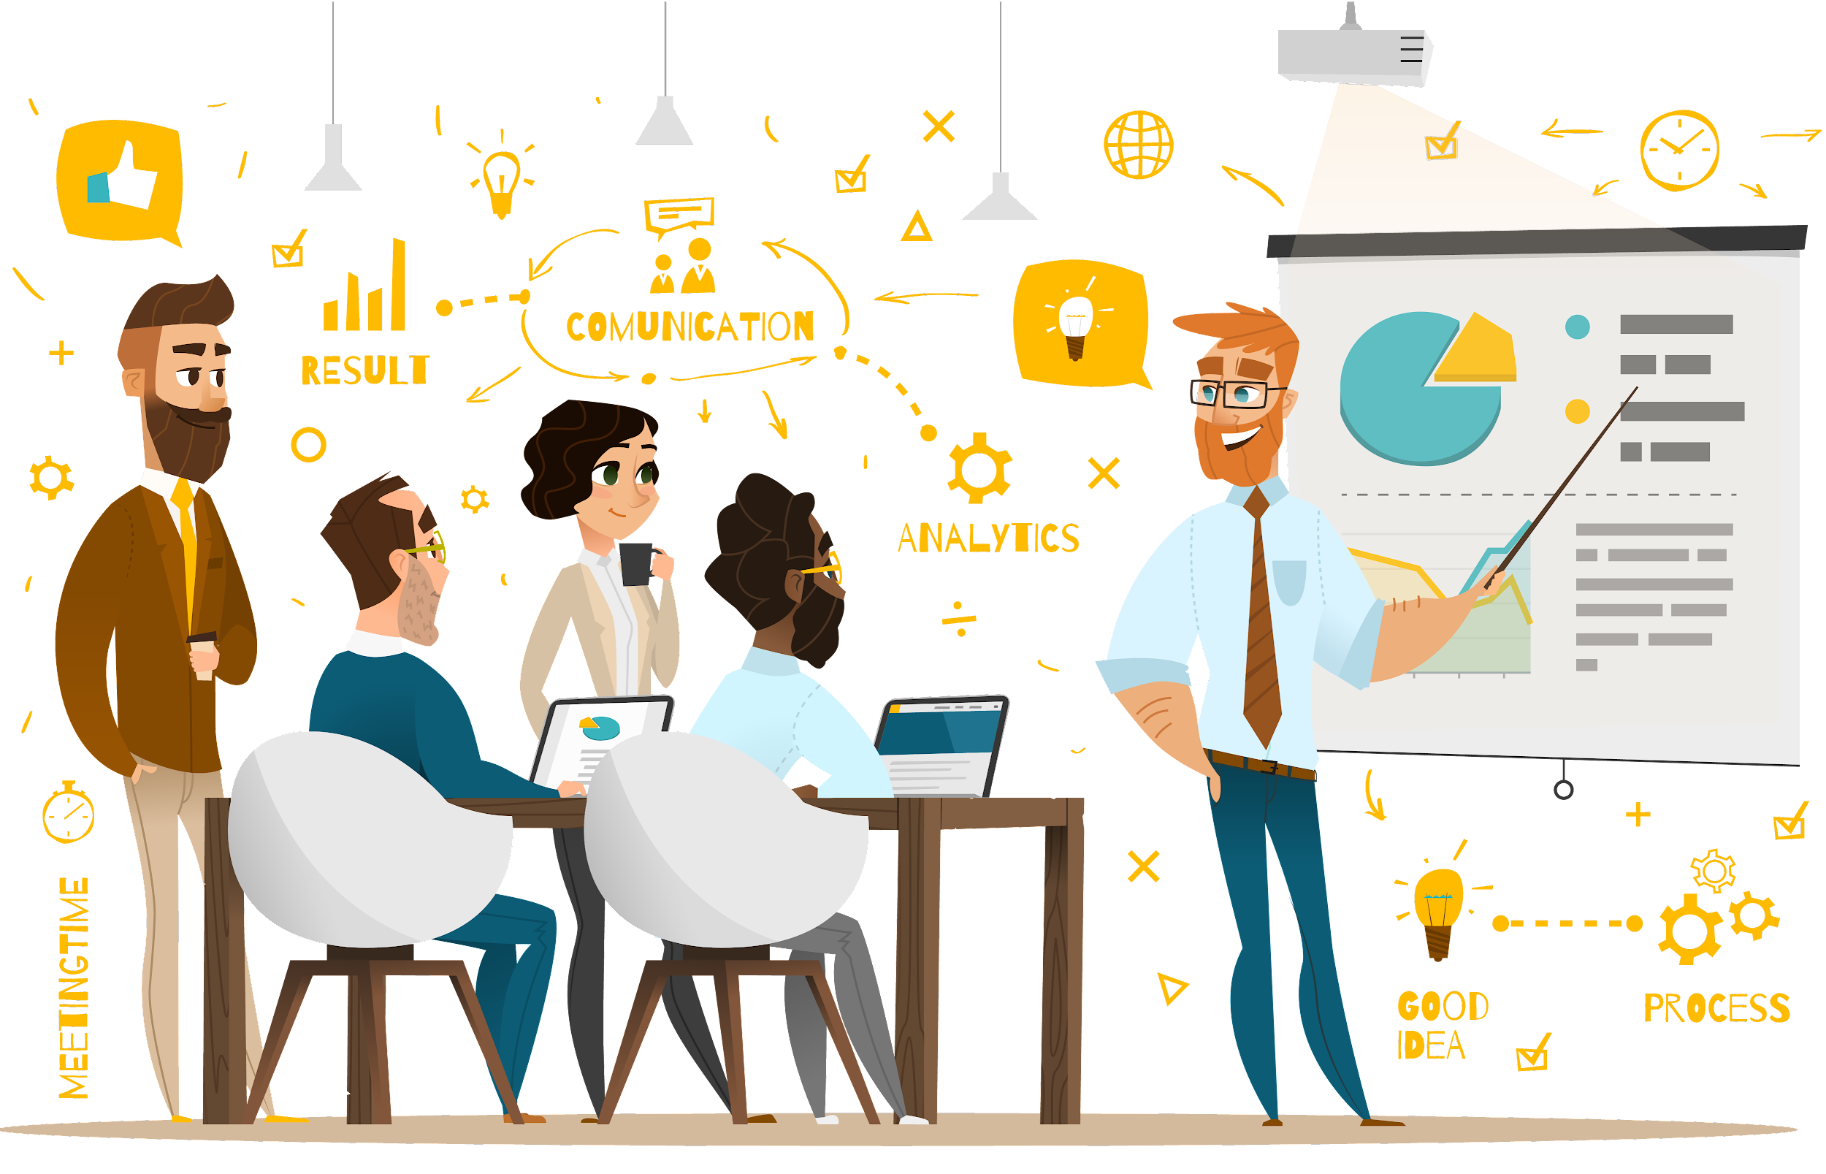

An on-brand and accessible user interface (UI) for prospective clients, partnerships and funders.
Improved user experience (UX) for the existing WordPress environment.
For the website to be mobile responsive/first as well as to be search engine optimised.
Project Summary
Project Plan
Exploration
Impact
Schedule
Constraints

Slide 3

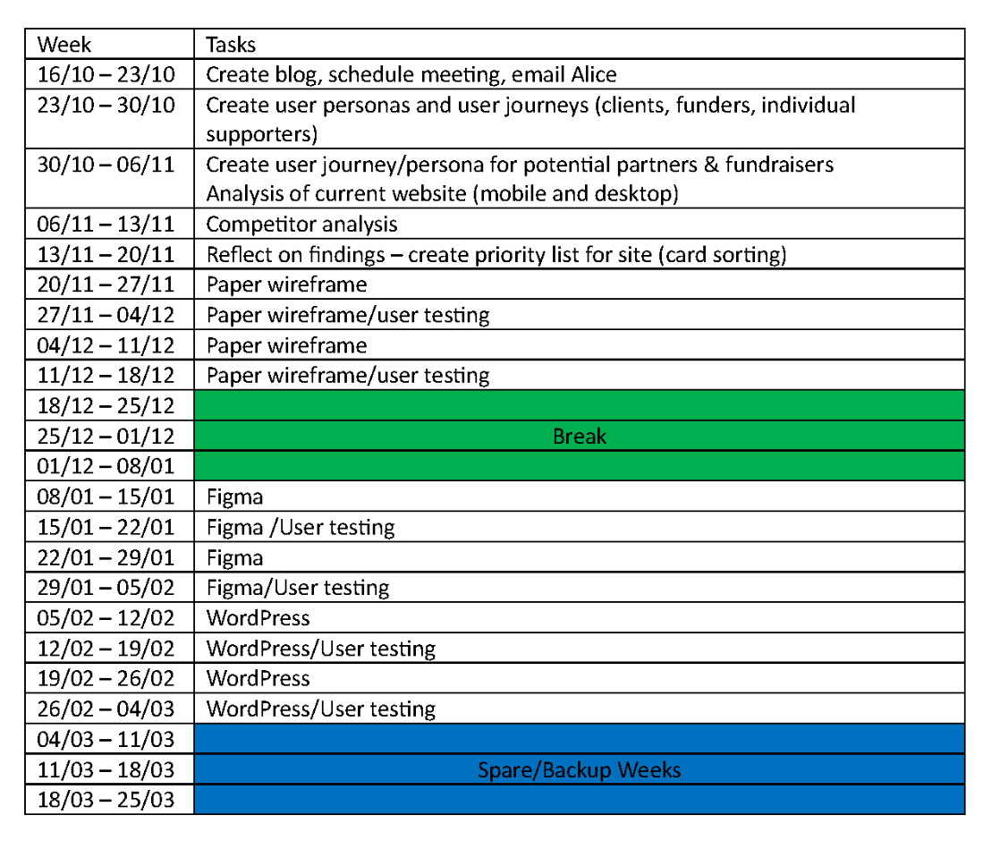
Project Summary
Project Plan
Last Three Months
Impact
Constraints
Schedule

Slide 4
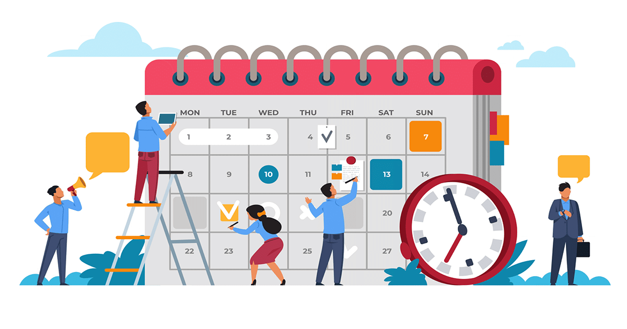
Project Summary
Project Plan
Created two User Personas and User Journeys for Clients, Partnerships, One time funders and Funders
Website analysis (mobile & desktop)/Partnership analysis (mobile & desktop)
Card Sorting
Low-fi Wireframe (mobile & desktop)
Last Three Months
Current Step
Constraints
Schedule

Slide 5
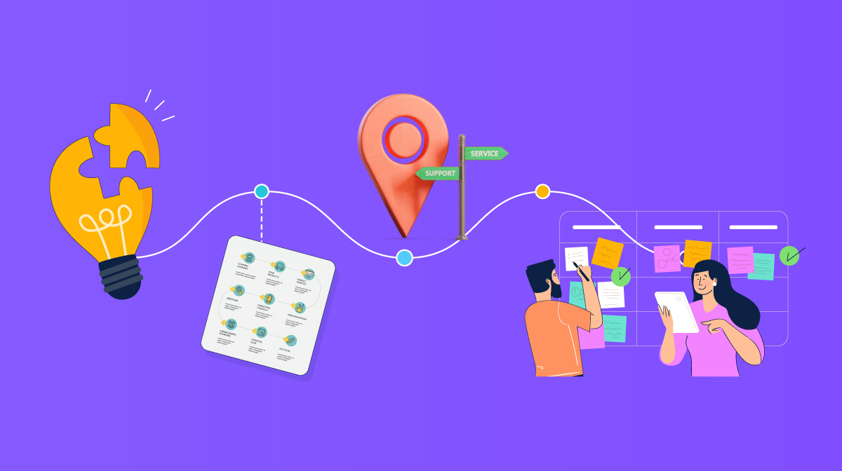
Project Summary
Current Situation
Last Three
Months
Create mid/high fidelity prototype in figma for mobile and desktop
Move onto example page in WordPress
Current Step
Next Steps
Schedule

Slide 6

Project Summary
Current Situation
Exploration
Current Step
Next Steps
Questions

Slide 7

Project Summary
Current Situation
Exploration
Impact
Next Step
Questions

